Slide 1
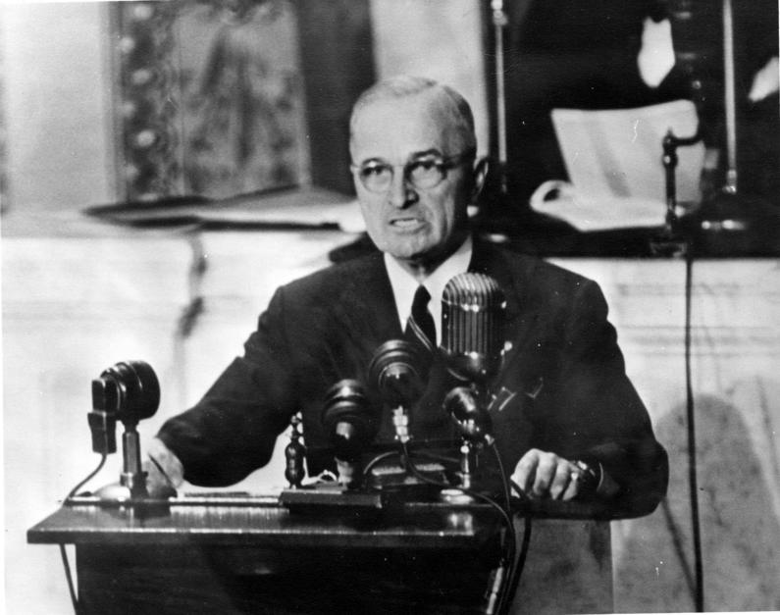
The BIG Question – Paper 1
How to answer the (16) mark Question on Paper 1.

Slide 2
Why is the 16 mark question important?
This question is the make or break question on the paper!
It is worth a total of 16 marks out of the possible 53.
This is 30% of the marks for the whole paper.

Slide 3
You will have about 30 minutes to do complete it.

Slide 4
It is the difference between 3 grade boundaries -

Slide 5
What does one look like?
Answer Question 6.
Spelling, punctuation and grammar will be assessed in this question.
6 Explain why relations between the USA and the Soviet Union grew worse in the period 1945–48. (13)
You may use the following in your answer.
• Capitalism and communism
• The Berlin Blockade.
You must also include information of your own.

Slide 6
Spelling, punctuation and grammar:
You are assessed on your SPAG in this question
3 marks being awarded.
13+3=16

Slide 7
Note the two countries involved.
Focus only on their relationship.
6 Explain why relations between the USA and the Soviet Union grew worse in the period 1945–48. (13)
You may use the following in your answer.
• Capitalism and communism
• The Berlin Blockade.
You must also include information of your own.

Slide 8
You need to focus on
the events, things, issues etc which made the relationship worse as time
went on.
6 Explain why relations between the USA and the Soviet Union grew worse in the period 1945–48. (13)
You may use the following in your answer.
• Capitalism and communism
• The Berlin Blockade.
You must also include information of your own.

Slide 9
Closely note the time brackets – these bookend what you should write about – focus on events within this time frame.
6 Explain why relations between the USA and the Soviet Union grew worse in the period 1945–48. (13)
You may use the following in your answer.
• Capitalism and communism
• The Berlin Blockade.
You must also include information of your own.

Slide 10
6 Explain why relations between the USA and the Soviet Union grew worse in the period 1945–48. (13)
You may use the following in your answer.
• Capitalism and communism
• The Berlin Blockade.
You must also include information of your own.
Here the exam board are giving you at least 2 topics to write about.

Slide 11
6 Explain why relations between the USA and the Soviet Union grew worse in the period 1945–48. (13)
You may use the following in your answer.
• Capitalism and communism
• The Berlin Blockade.
You must also include information of your own.
But you need to write about 3 “things” to achieve a top level so you will need to include one or more of your own.
Here the exam board are giving you at least 2 topics to write about.

Slide 12
What to include to achieve the top level:
3 explicit causes.
You will need to explain their RELATIVE IMPORTANCE.
Use qualifiers to help this – “The MOST important, the LEAST…”
Show the inter-relations between the three factors – eg LINKING.
Describe the “thing” briefly then EXPLAIN how it did the thing which is the focus of the question.

Slide 13
What to include in this question…
How many to write about?
Communism v Capitalism
Disagreements at Yalta and Potsdam
Satellite States
Marshall Plan v Comecon
Truman Doctrine
Berlin Blockade

Slide 14
Communism v Capitalism
The USA was a democratic capitalist state.
The USSR was a communist dictatorship.
This would make it difficult for them to get on with each other in normal circumstances. Opposites.
Once shared enemy defeated – no reason to remain on good terms.
Stalin had always felt that the capitalist west had wanted to destroy communism since the revolution of 1917.
This was largely true.
Roosevelt had tried to work with Stalin, Truman did not share this desire.
Suspicion and distrust characterised their early relationship.

Slide 15
Disagreements at Yalta and Potsdam 1945.
Although the media saw only smiles at the Grand Alliance conferences – there was a great deal of distrust and disagreement.
The USA and UK wanted Stalin to agree to free elections in those countries occupied by the Red Army after the war.
Stalin wanted to create a sphere of influence in the east to spread communism and prevent further western invasions of Russia.
USA had the Atomic Bomb by July 1945.
Roosevelt was replaced by Truman who did not trust Stalin.

Slide 16
Truman Doctrine
Truman announces in 1946 – prompted by the Long Telegram, Churchill’s Iron Curtain speech and the creation of communist satellite states in the east and change of USA foreign policy.
The Truman Doctrine stated that the policy of the USA would be to prevent the spread of communism throughout the world.
Move away from entente to containment.

Slide 17
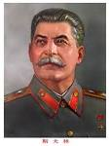
Sees this as an attempt to stop the spread of communism and a threat to his sphere of influence.
Attempt to spread “evil capitalism” around the world.
Sees this a remaining firm in the face of communist attempts to spread their influence and reduce freedom.
An attempt to stop the spread of “evil communism.”

Slide 18
Satellite States
Stalin had been given permission to set up communist puppet governments in countries liberated by the Red Army until the end of the war.
Stalin had agreed to give these countries democratic free elections after Hitler was defeated.
Stalin broke this agreement and created satellite states behind an Iron Curtain of communist Soviet control.
It was important to his plan for an eastern sphere of influence and to maintain a buffer against a future western invasion.

Slide 19
Marshall Plan v Comecon
Truman sent General Marshall to tour war damaged Europe.
Marshall reported back that the poverty created by the destruction was providing a fertile ground for the spread of communism.
Truman decided that the USA would give millions $ to the countries of Europe to help them recover.
Stopped the spread of communism.
Help Europe recover so it could both trade again with the USA and begin to defend itself against the threat of the USSR.
Stalin furious – capitalism trying to buy influence. Forbade satellite states from taking US money – set up COMECON to aid communist countries.

Slide 20
Berlin Blockade
This is when the growing Cold War became HOT.
Truman Doctrine meant that the USA could not back down in face of Soviet aggression.
Stalin eventually ended the blockade. The relationship between USA and USSR was now effectively one of rivals and enemies.
West created NATO to counter threat of USSR.
Arms race begins involving atomic weapons.
Warsaw Pact set up to counter NATO.
Cold War has properly begun.

Slide 21
So writing the essay…
Cause 1: Communism V Capitalism
Cause 2: Truman Doctrine
Cause 3: Berlin Blockade
Conclusion – rank ordering and linking.

Slide 22
Example…
Qualifier
Point
An important cause of the worsening of the relationship between the USA and the USSR was Stalin’s creation of satellite states. A satellite state was a country which was a puppet under the control of the USSR. This worsened relations because all though important to Stalin’s plans to create a sphere of influence in the east as a buffer against the west it broke his agreement to hold democratic elections after the war. The USA saw the satellite states as the USSR extending communism into countries through force and a danger to world peace and freedoms.
Description
Explanation linked to
the question focus.

